Slide 1

ITC 6000 Database Management Systems Final Project Presentation 2023 Fall B Project Title:
Enhancing Hospital Efficiency: Crafting a Healthcare Management Database
Group 2:
Andrew Amartei Aravind Korutla Priscilla Asare Yijia Wang

Slide 2
Overview
Introduction
Use Cases
Business Rules
ER Diagram
Project Architecture
Major SQL queries
Security & Privacy Concerns
Next steps / Lessons learned
Recommendations

Slide 3
INTRODUCTION
The project focuses on developing a healthcare management database for hospitals to improve operational efficiency. It aims to streamline patient information, appointment scheduling, and medical records.
The comprehensive data includes personal information, medical history, insurance records, appointment schedules, and vital medical records like diagnoses and laboratory results.
Ensuring the security of sensitive information, in compliance with regulations such as HIPAA, is a crucial aspect of the project.
However, the project has narrowed its scope to analyze factors contributing to the presence or absence of heart diseases using a chosen dataset from Kaggle.

Slide 4

System Beneficiaries
Patients:
Access records and schedule appointments with transparency and ease.
Medical Practitioners:
Manage patient information and treatment records, enhancing service quality.
Administrative Staff:
Oversee appointment scheduling, medical records, billing, and insurance tasks for smooth hospital operations.

Slide 5

Primary Use Cases
Patient Record Management:
Efficiently organize and access patient data for enhanced care and decision-making.
Appointment Scheduling:
Streamline appointment booking and scheduling for patient convenience.
Medical Record Handling:
Safely store, retrieve, and manage medical records, ensuring data integrity and security.
Billing and Insurance Management:
Facilitate financial aspects of patient care and insurance claims.
HIPAA Compliance:
Ensure strict compliance with regulations, such as HIPAA, for safeguarding patient data

Slide 6

Business Rules
Each patient is identified by their unique patient ID and may have several records in the database.
Each patient record has a cardiac assessment. For any patient deemed to have a heart issue, a heart metric record is created.
Each doctor attends to a minimum of 10 patients.
Every patient record includes a heart disease status.
A treatment plan must be included in a patient record when the heart disease status is positive.

Slide 7
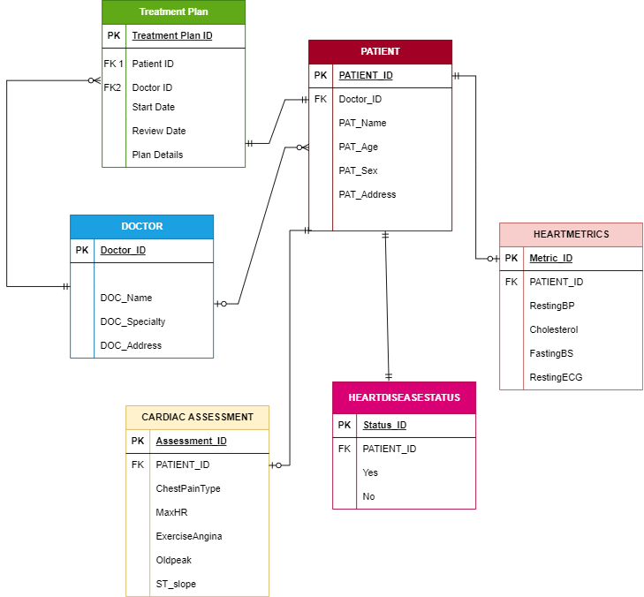
ER Diagram

Slide 8

Project Architecture
Tools for efficient handling of patient records, assessments, and treatment plans.
A storage engine for organized and secure data.
Consideration of a client/server setup for control and adherence to health regulations.
Contemplation of cloud services for scalability and remote accessibility.
Emphasis on data integrity, compliance, and regular database backups.

Slide 9
SQL QUERIES
Retrieve all patients who are 40 yrs and above with MaxHR above 170 and their Heart disease status :
SELECT p.Patient_ID, p.PAT_Name,p.PAT_Sex, h.RestingBP, h.Cholesterol, h.FastingBS, h.RestingECG, c.MaxHR,hd.HEART_DISEASE_STATUS
FROM PATIENT p
JOIN HEARTMETRICS h on h.Patient_ID = p.Patient_ID
JOIN HEARTDISEASESTATUS hd on hd.Patient_ID = p.Patient_ID
JOIN CARDIAC_ASSESSMENT c on c.Patient_ID = p.Patient_ID
WHERE p.PAT_Age <= 40
AND c.MaxHR = 170;

Slide 10
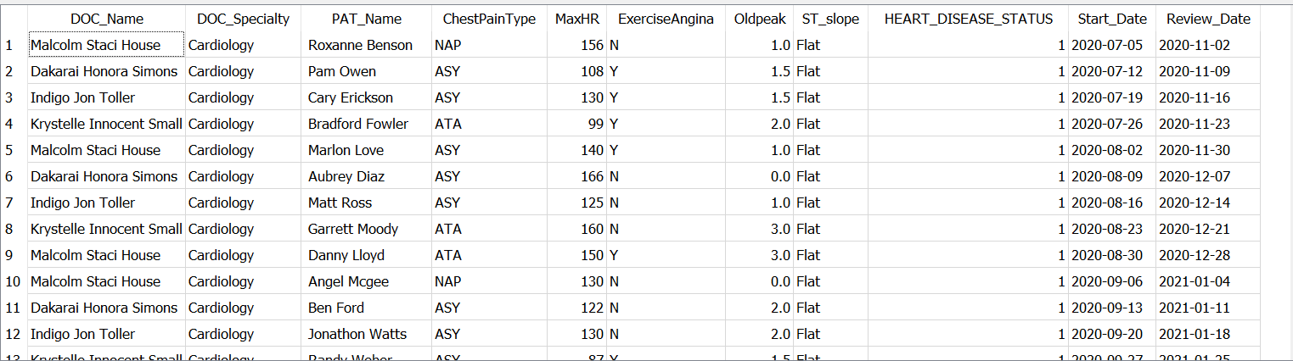
SQL QUERIES
Retrieve doctors who are Cardiac specialist, their patients, Cardiac assessment for the patient, the heart disease status of the patients and their treatment plan
SELECT DOC_Name, DOC_Specialty, p.PAT_Name,c.ChestPainType, c.MaxHR,c.ExerciseAngina,c.Oldpeak,c.ST_slope ,hd.HEART_DISEASE_STATUS,t.Start_Date, t.Review_Date
FROM PATIENT p
JOIN DOCTOR d on d.Doctor_ID = p.Doctor_ID
JOIN HEARTDISEASESTATUS hd on hd.Patient_ID = p.Patient_ID
JOIN TREATMENT_PLAN t on t.Patient_ID = p.Patient_ID
JOIN CARDIAC_ASSESSMENT c on c.Patient_ID = p.Patient_ID
where d.DOC_Specialty = 'Cardiology' ;

Slide 11
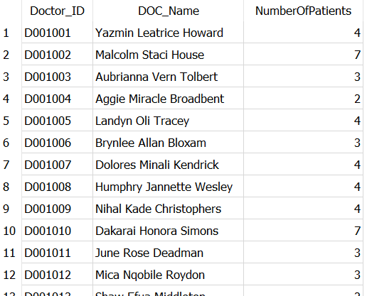
SQL QUERIES
Count the Number of Patients Treated by Each Doctor
SELECT Doctor.Doctor_ID, Doctor.DOC_Name, COUNT(Patient.Patient_ID) AS NumberOfPatients
FROM Doctor
JOIN Patient ON Doctor.Doctor_ID = Patient.Doctor_ID
GROUP BY Doctor.Doctor_ID, Doctor.DOC_Name;

Slide 12
Security and Privacy
Sensitive Data: Patient details, medical records, insurance information.
Potential Target: Hackers may target valuable health data.
Security Considerations: Regular database backups and secure data handling which involves employing effective encryption protocols for sensitive information, implementing access controls and user authentication mechanisms, adhering to industry best practices, and conducting periodic security audits and assessments aids in identifying vulnerabilities.
Communication with Security Team: Keeping them informed about data sensitivity and potential risks. The ISOs, security analysts, security architects and compliance officers.

Slide 13
Next steps / Lessons Learned
Next Steps:
Develop the database system based on our architecture.
Implement necessary features.
Ensure compliance with HIPAA.
Conduct testing
Conduct security assessment and address gaps.
Evaluation and continuous improvement of the system.
Lessons:
Clear understanding and documentation of ideas
Effective communication among team members
Knowledge sharing.

Slide 14
Recommendations
Ensuring that the database system can communicate and integrate with other systems used in the hospitals.
Implement a good backup strategy in case of cyberattacks.
Conduct frequent security monitoring and analysis to identify and address potential threats.
Incorporating analytics tools to derive insights.

